Slide 1
Chapter 14: Mass-Storage Systems
Disk Structure
Disk Scheduling
Disk Management
Swap-Space Management
RAID Structure
Disk Attachment
Stable-Storage Implementation
Tertiary Storage Devices
Operating System Issues
Performance Issues

Slide 2
Disk Structure
Disk drives are addressed as large 1-dimensional arrays of logical blocks, where the logical block is the smallest unit of transfer.
The 1-dimensional array of logical blocks is mapped into the sectors of the disk sequentially.
  Sector 0 is the first sector of the first track on the outermost cylinder.
  Mapping proceeds in order through that track, then the rest of the tracks in that cylinder, and then through the rest of the cylinders from outermost to innermost.

Slide 3
Disk Scheduling
The operating system is responsible for using hardware efficiently — for the disk drives, this means having a fast access time and disk bandwidth.
Access time has two major components
  Seek time is the time for the disk are to move the heads to the cylinder containing the desired sector.
  Rotational latency is the additional time waiting for the disk to rotate the desired sector to the disk head.
Minimize seek time
Seek time ≈ seek distance
Disk bandwidth is the total number of bytes transferred, divided by the total time between the first request for service and the completion of the last transfer.

Slide 4
Disk Scheduling (Cont.)
Several algorithms exist to schedule the servicing of disk I/O requests.
We illustrate them with a request queue (0-199).
98, 183, 37, 122, 14, 124, 65, 67
Head pointer 53

Slide 5
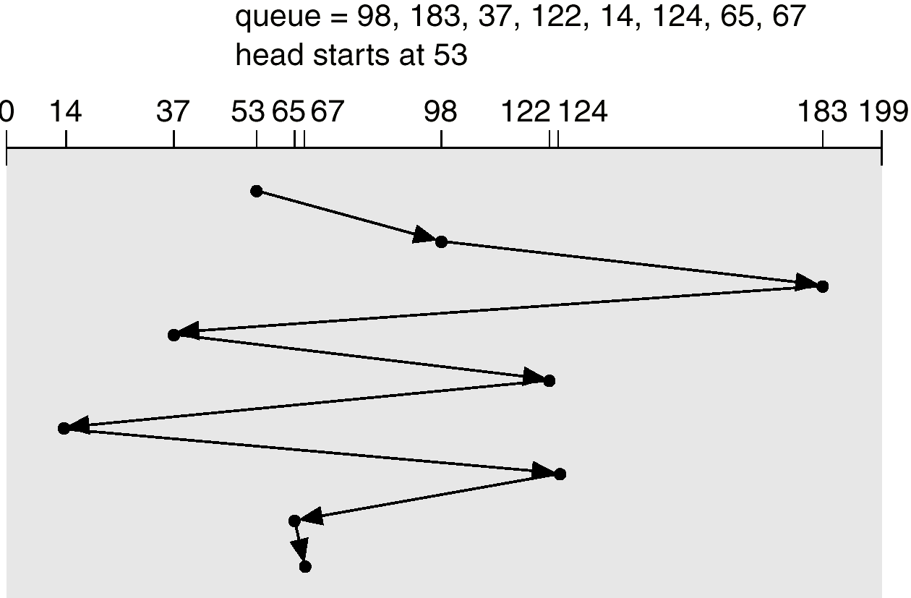
FCFS
Illustration shows total head movement of 640 cylinders.

Slide 6
SSTF
Selects the request with the minimum seek time from the current head position.
SSTF scheduling is a form of SJF scheduling; may cause starvation of some requests.
Illustration shows total head movement of 236 cylinders.

Slide 7
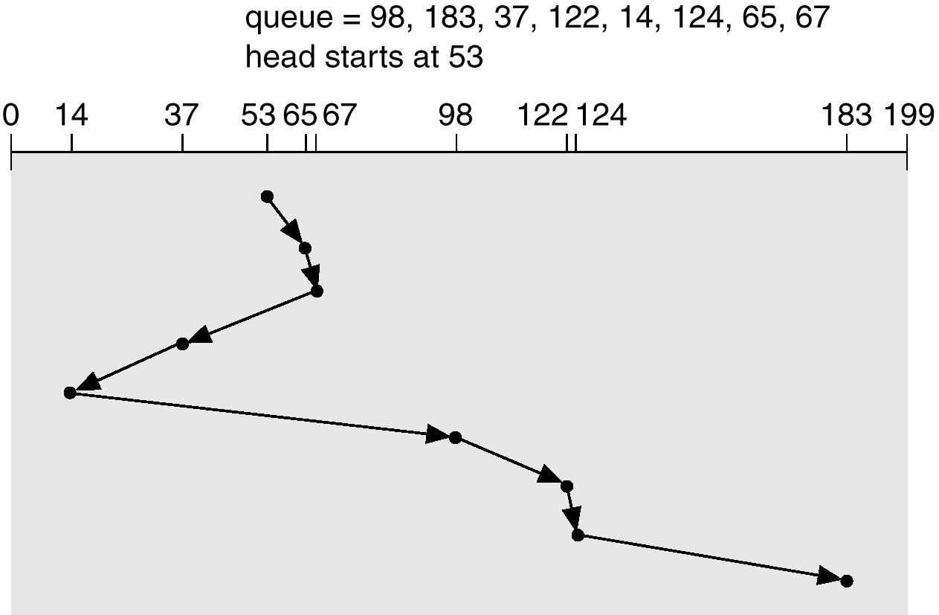
SSTF (Cont.)

Slide 8
SCAN
The disk arm starts at one end of the disk, and moves toward the other end, servicing requests until it gets to the other end of the disk, where the head movement is reversed and servicing continues.
Sometimes called the elevator algorithm.
Illustration shows total head movement of 208 cylinders.

Slide 9
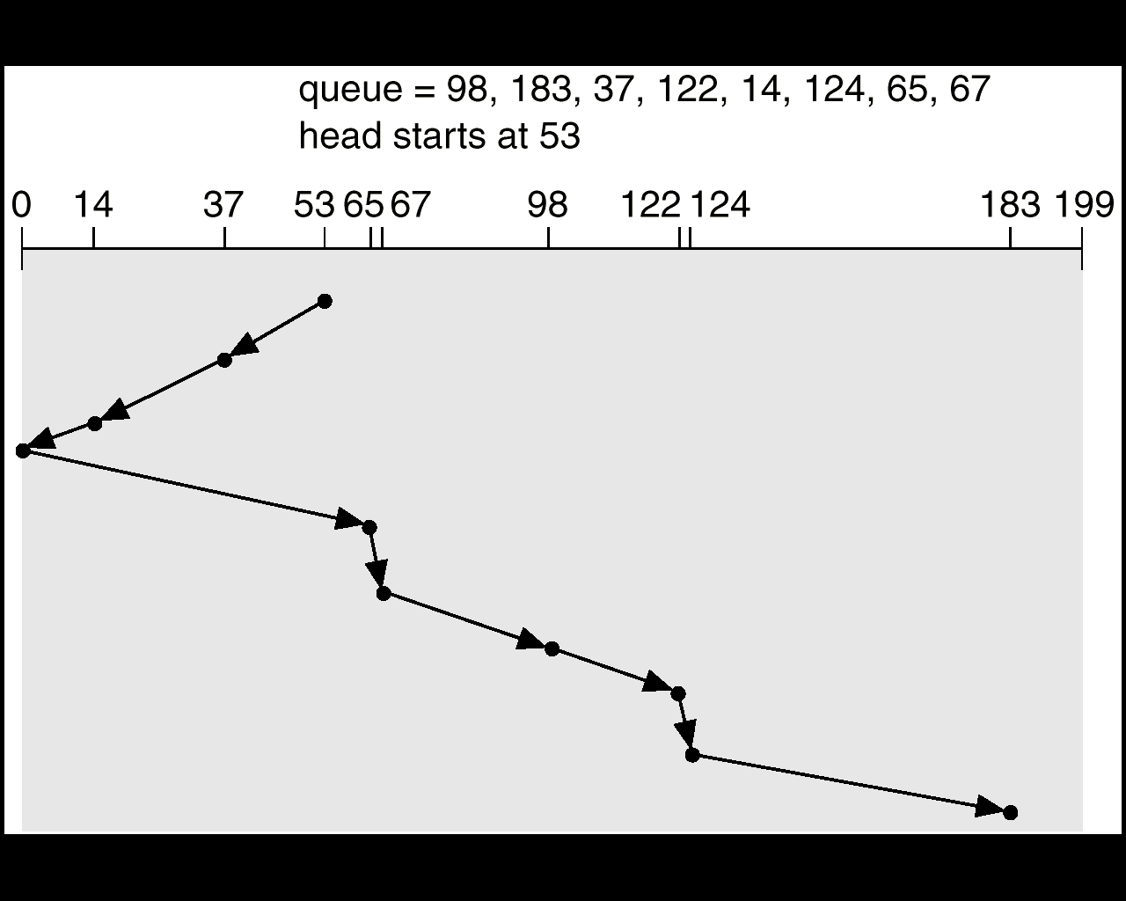
SCAN (Cont.)

Slide 10
C-SCAN
Provides a more uniform wait time than SCAN.
The head moves from one end of the disk to the other. servicing requests as it goes. When it reaches the other end, however, it immediately returns to the beginning of the disk, without servicing any requests on the return trip.
Treats the cylinders as a circular list that wraps around from the last cylinder to the first one.

Slide 11
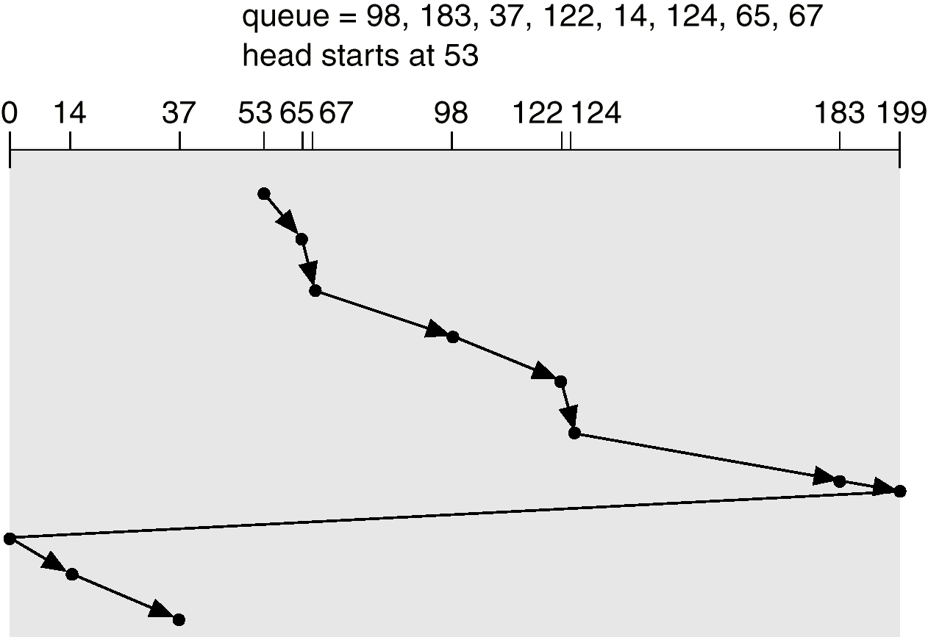
C-SCAN (Cont.)

Slide 12
C-LOOK
Version of C-SCAN
Arm only goes as far as the last request in each direction, then reverses direction immediately, without first going all the way to the end of the disk.

Slide 13
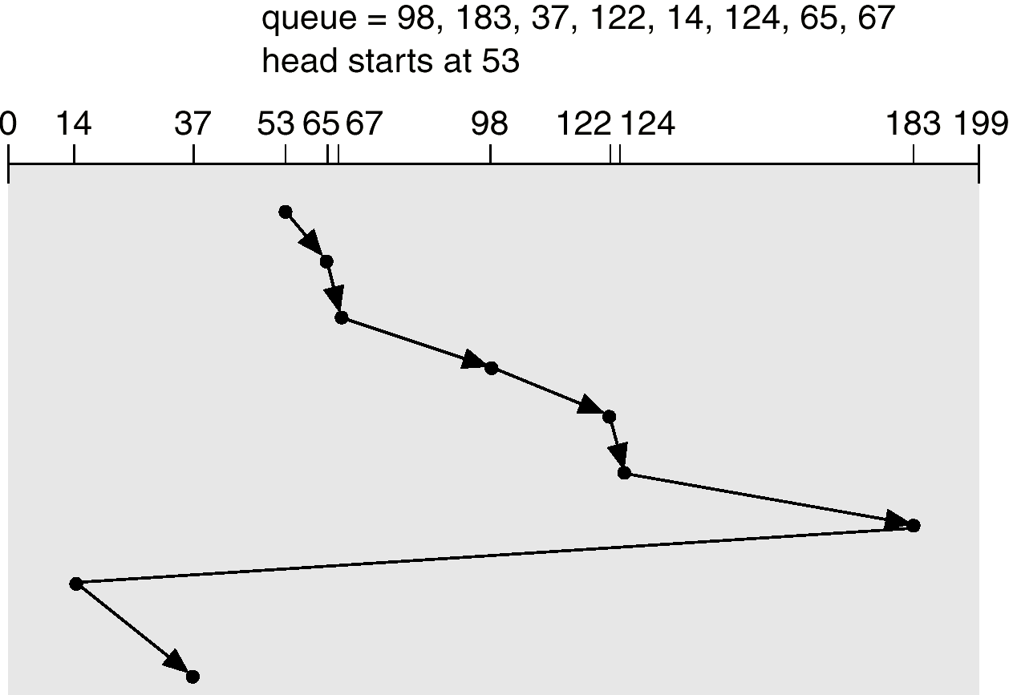
C-LOOK (Cont.)

Slide 14
Selecting a Disk-Scheduling Algorithm
SSTF is common and has a natural appeal
SCAN and C-SCAN perform better for systems that place a heavy load on the disk.
Performance depends on the number and types of requests.
Requests for disk service can be influenced by the file-allocation method.
The disk-scheduling algorithm should be written as a separate module of the operating system, allowing it to be replaced with a different algorithm if necessary.
Either SSTF or LOOK is a reasonable choice for the default algorithm.

Slide 15
Disk Management
Low-level formatting, or physical formatting — Dividing a disk into sectors that the disk controller can read and write.
To use a disk to hold files, the operating system still needs to record its own data structures on the disk.
  Partition the disk into one or more groups of cylinders.
  Logical formatting or “making a file system”.
Boot block initializes system.
  The bootstrap is stored in ROM.
  Bootstrap loader program.
Methods such as sector sparing used to handle bad blocks.

Slide 16
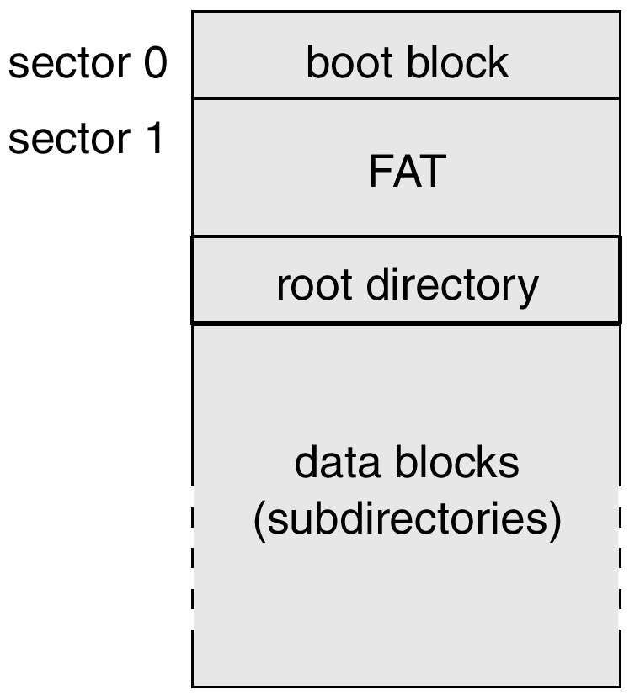
MS-DOS Disk Layout

Slide 17
Swap-Space Management
Swap-space — Virtual memory uses disk space as an extension of main memory.
Swap-space can be carved out of the normal file system,or, more commonly, it can be in a separate disk partition.
Swap-space management
  4.3BSD allocates swap space when process starts; holds text segment (the program) and data segment.
  Kernel uses swap maps to track swap-space use.
  Solaris 2 allocates swap space only when a page is forced out of physical memory, not when the virtual memory page is first created.

Slide 18
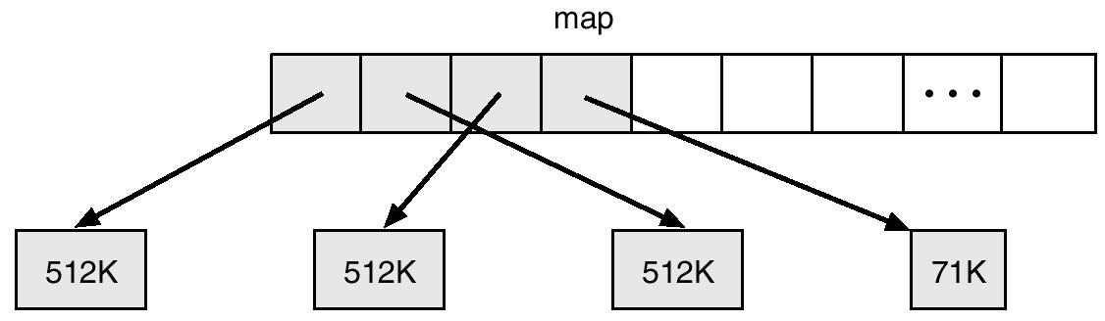
4.3 BSD Text-Segment Swap Map

Slide 19
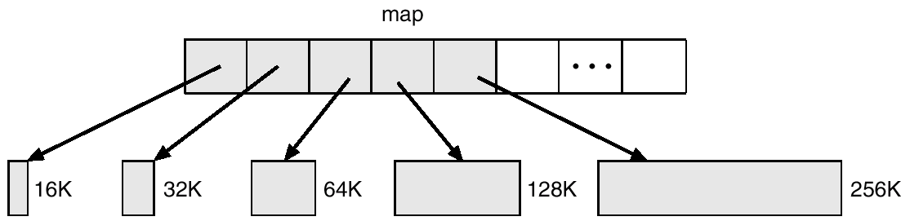
4.3 BSD Data-Segment Swap Map

Slide 20
RAID Structure
RAID – multiple disk drives provides reliability via redundancy.
RAID is arranged into six different levels.

Slide 21
RAID (cont)
Several improvements in disk-use techniques involve the use of multiple disks working cooperatively.
Disk striping uses a group of disks as one storage unit.
RAID schemes improve performance and improve the reliability of the storage system by storing redundant data.
  Mirroring or shadowing keeps duplicate of each disk.
  Block interleaved parity uses much less redundancy.

Slide 22
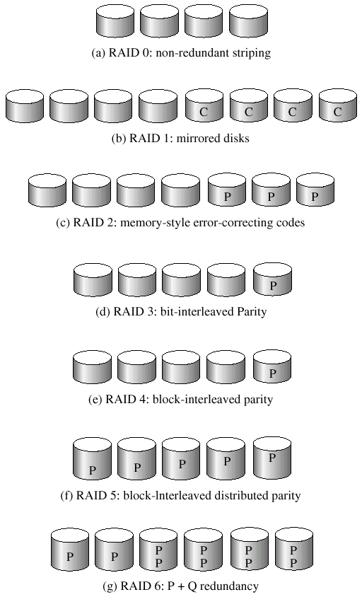
RAID Levels

Slide 23
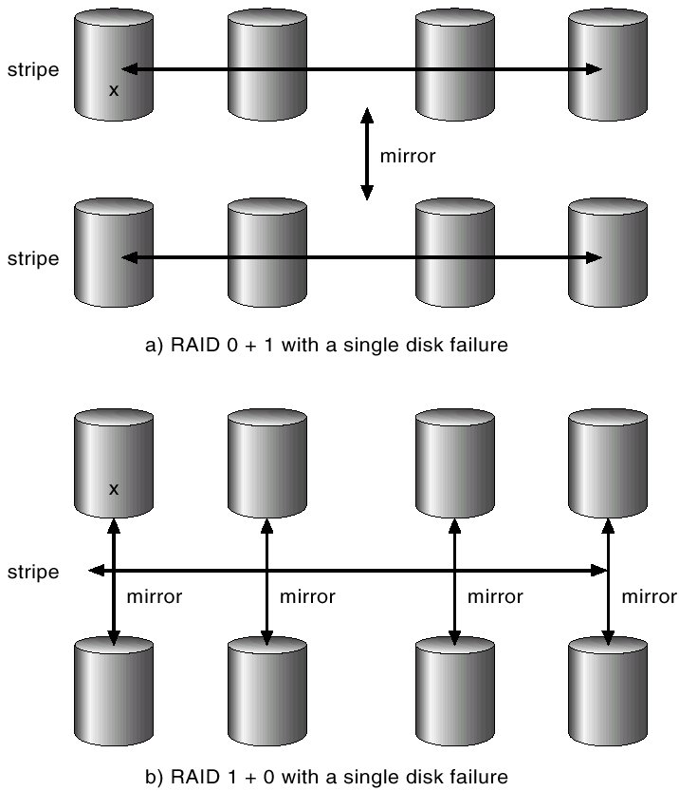
RAID (0 + 1) and (1 + 0)

Slide 24
Disk Attachment
Disks may be attached one of two ways:
Host attached via an I/O port
Network attached via a network connection

Slide 25
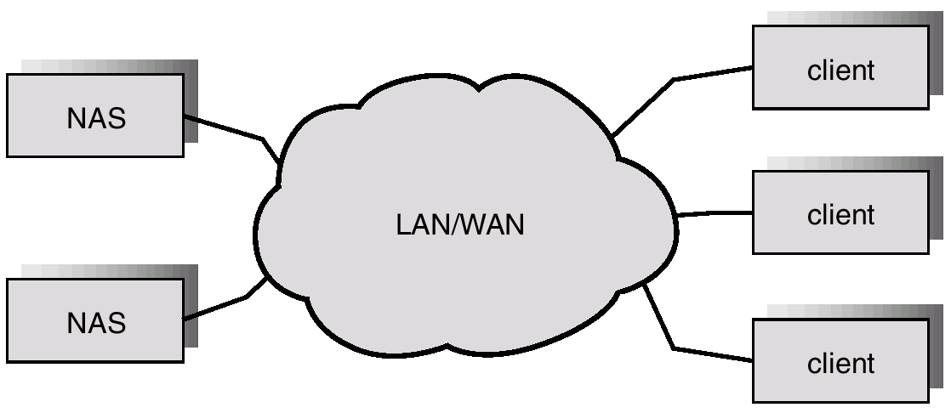
Network-Attached Storage

Slide 26
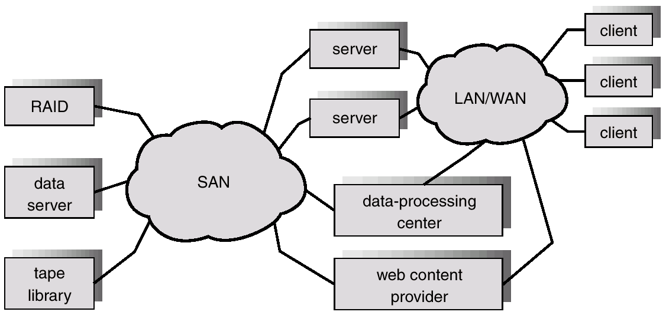
Storage-Area Network

Slide 27
Stable-Storage Implementation
Write-ahead log scheme requires stable storage.
To implement stable storage:
  Replicate information on more than one nonvolatile storage media with independent failure modes.
  Update information in a controlled manner to ensure that we can recover the stable data after any failure during data transfer or recovery.

Slide 28
Tertiary Storage Devices
Low cost is the defining characteristic of tertiary storage.
Generally, tertiary storage is built using removable media
Common examples of removable media are floppy disks and CD-ROMs; other types are available.

Slide 29
Removable Disks
Floppy disk — thin flexible disk coated with magnetic material, enclosed in a protective plastic case.
  Most floppies hold about 1 MB; similar technology is used for removable disks that hold more than 1 GB.
  Removable magnetic disks can be nearly as fast as hard disks, but they are at a greater risk of damage from exposure.

Slide 30
Removable Disks (Cont.)
A magneto-optic disk records data on a rigid platter coated with magnetic material.
  Laser heat is used to amplify a large, weak magnetic field to record a bit.
  Laser light is also used to read data (Kerr effect).
  The magneto-optic head flies much farther from the disk surface than a magnetic disk head, and the magnetic material is covered with a protective layer of plastic or glass; resistant to head crashes.
Optical disks do not use magnetism; they employ special materials that are altered by laser light.

Slide 31
WORM Disks
The data on read-write disks can be modified over and over.
WORM (“Write Once, Read Many Times”) disks can be written only once.
Thin aluminum film sandwiched between two glass or plastic platters.
To write a bit, the drive uses a laser light to burn a small hole through the aluminum; information can be destroyed by not altered.
Very durable and reliable.
Read Only disks, such ad CD-ROM and DVD, com from the factory with the data pre-recorded.

Slide 32
Tapes
Compared to a disk, a tape is less expensive and holds more data, but random access is much slower.
Tape is an economical medium for purposes that do not require fast random access, e.g., backup copies of disk data, holding huge volumes of data.
Large tape installations typically use robotic tape changers that move tapes between tape drives and storage slots in a tape library.
  stacker – library that holds a few tapes
  silo – library that holds thousands of tapes
A disk-resident file can be archived to tape for low cost storage; the computer can stage it back into disk storage for active use.

Slide 33
Operating System Issues
Major OS jobs are to manage physical devices and to present a virtual machine abstraction to applications
For hard disks, the OS provides two abstraction:
  Raw device – an array of data blocks.
  File system – the OS queues and schedules the interleaved requests from several applications.

Slide 34
Application Interface
Most OSs handle removable disks almost exactly like fixed disks — a new cartridge is formatted and an empty file system is generated on the disk.
Tapes are presented as a raw storage medium, i.e., and application does not not open a file on the tape, it opens the whole tape drive as a raw device.
Usually the tape drive is reserved for the exclusive use of that application.
Since the OS does not provide file system services, the application must decide how to use the array of blocks.
Since every application makes up its own rules for how to organize a tape, a tape full of data can generally only be used by the program that created it.

Slide 35
Tape Drives
The basic operations for a tape drive differ from those of a disk drive.
locate positions the tape to a specific logical block, not an entire track (corresponds to seek).
The read position operation returns the logical block number where the tape head is.
The space operation enables relative motion.
Tape drives are “append-only” devices; updating a block in the middle of the tape also effectively erases everything beyond that block.
An EOT mark is placed after a block that is written.

Slide 36
File Naming
The issue of naming files on removable media is especially difficult when we want to write data on a removable cartridge on one computer, and then use the cartridge in another computer.
Contemporary OSs generally leave the name space problem unsolved for removable media, and depend on applications and users to figure out how to access and interpret the data.
Some kinds of removable media (e.g., CDs) are so well standardized that all computers use them the same way.

Slide 37
Hierarchical Storage Management (HSM)
A hierarchical storage system extends the storage hierarchy beyond primary memory and secondary storage to incorporate tertiary storage — usually implemented as a jukebox of tapes or removable disks.
Usually incorporate tertiary storage by extending the file system.
  Small and frequently used files remain on disk.
  Large, old, inactive files are archived to the jukebox.
HSM is usually found in supercomputing centers and other large installations that have enormous volumes of data.

Slide 38
Speed
Two aspects of speed in tertiary storage are bandwidth and latency.
Bandwidth is measured in bytes per second.
  Sustained bandwidth – average data rate during a large transfer; # of bytes/transfer time.
  Data rate when the data stream is actually flowing.
  Effective bandwidth – average over the entire I/O time, including seek or locate, and cartridge switching.
  Drive’s overall data rate.

Slide 39
Speed (Cont.)
Access latency – amount of time needed to locate data.
  Access time for a disk – move the arm to the selected cylinder and wait for the rotational latency; < 35 milliseconds.
  Access on tape requires winding the tape reels until the selected block reaches the tape head; tens or hundreds of seconds.
  Generally say that random access within a tape cartridge is about a thousand times slower than random access on disk.
The low cost of tertiary storage is a result of having many cheap cartridges share a few expensive drives.
A removable library is best devoted to the storage of infrequently used data, because the library can only satisfy a relatively small number of I/O requests per hour.

Slide 40
Reliability
A fixed disk drive is likely to be more reliable than a removable disk or tape drive.
An optical cartridge is likely to be more reliable than a magnetic disk or tape.
A head crash in a fixed hard disk generally destroys the data, whereas the failure of a tape drive or optical disk drive often leaves the data cartridge unharmed.

Slide 41
Cost
Main memory is much more expensive than disk storage
The cost per megabyte of hard disk storage is competitive with magnetic tape if only one tape is used per drive.
The cheapest tape drives and the cheapest disk drives have had about the same storage capacity over the years.
Tertiary storage gives a cost savings only when the number of cartridges is considerably larger than the number of drives.

Slide 42
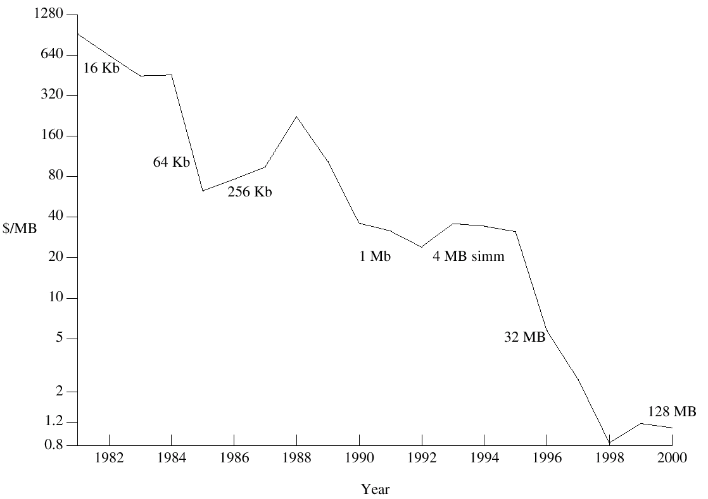
Price per Megabyte of DRAM, From 1981 to 2000

Slide 43
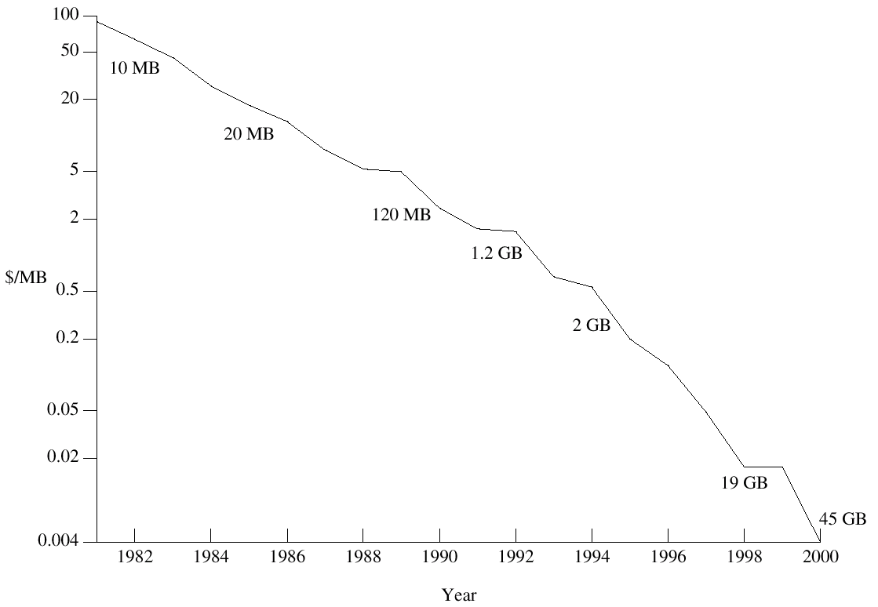
Price per Megabyte of Magnetic Hard Disk, From 1981 to 2000

Slide 44
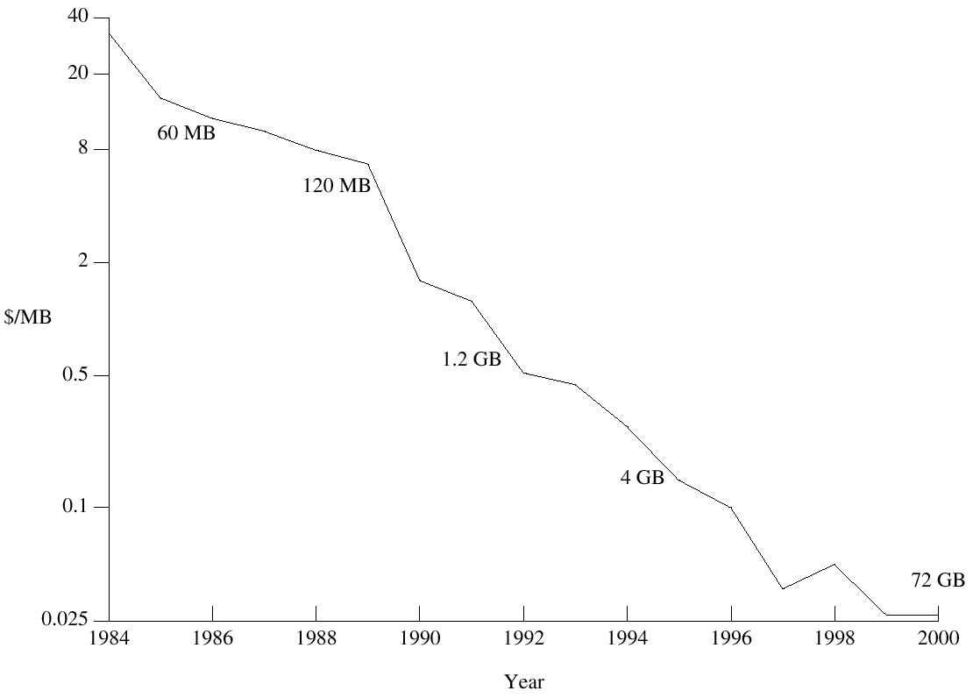
Price per Megabyte of a Tape Drive, From 1984-2000

